Slide 1
Bereavement
Petro Boshoff
Social Worker
Thuso
North West University
Potchefstroom

Slide 2
What is bereavement?
Bereavement also known
as grief, is the period after
a loss: this might be the
loss of a close
family member,
a friend or a partner.
Unique to everyone
Mourning is normal.

Slide 3
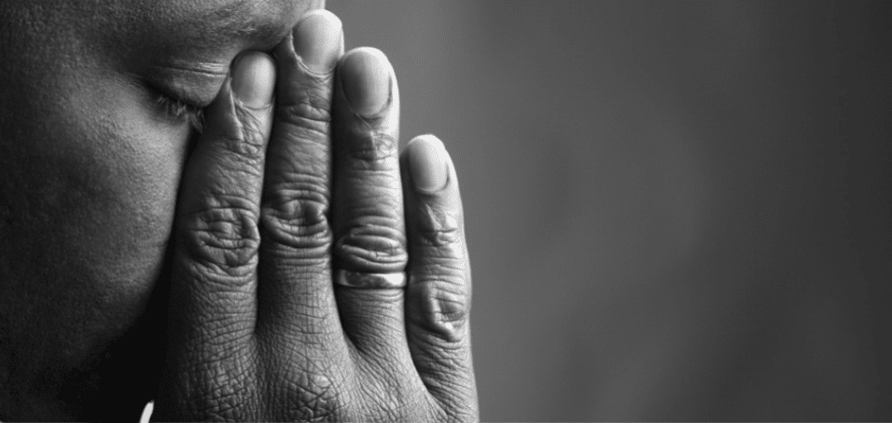
What symptoms can I experience?
Shock and disbelieve
Denial / Anger
Guilt
Sadness
Depressed
Meaningless

Slide 4
What can I do?
Take time to grieve in your own way
Admit your feelings
Talk to friends and relatives
Keep order in your surroundings
Look after yourself
Support from professionals

Slide 5
Thank you

